Slide 1
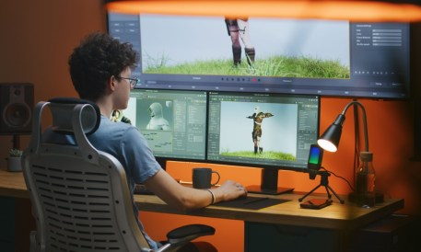





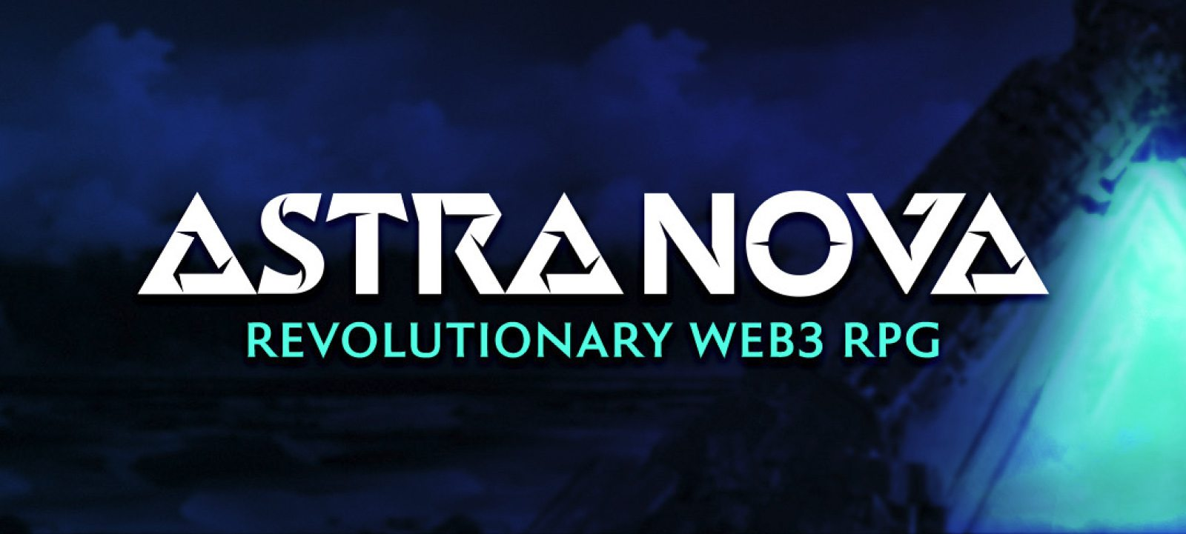
AI Startup and Gaming
Undergraduate Degree in Management Information System
MIS Innovation and New Technologies
Semester 241 – MIS-315
Name: Mujtaba Zaman
ID: 202132090
Due Date: 26/Oct/2024
Week: 9
Sec: 1
Instructor Name: MUSTAFA AHMED

Slide 2
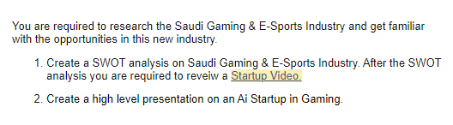
Question

Slide 3

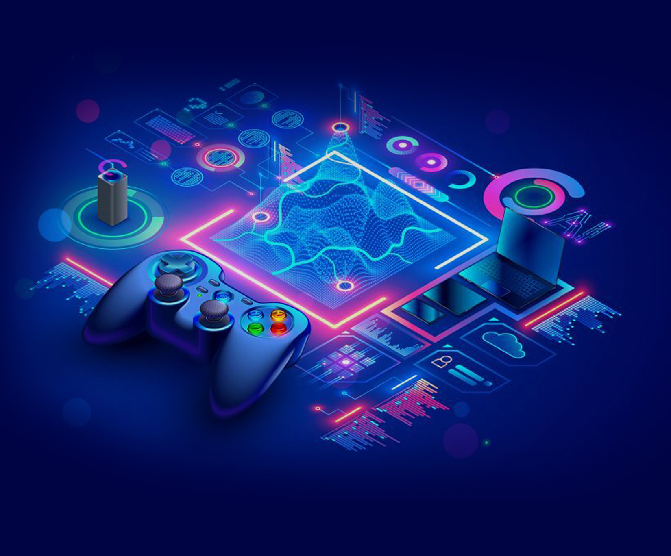
Introduction
It is a new industry
AI can transform many parts of playing games like NPC behavior and procedural content.
It is transforming how games are played and where it is played
There are rules and regulations that are not implemented/ made until now

Slide 4
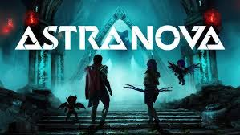
Startup Landscape in KSA
There are many startups in Saudi Arabia like Astra Nova that incorporates user generated content, AI, and AAA Graphics to transform the gameplay experience.
Zoaverse that allows people to collaborate with each other in a virtual world that can be a classroom, conference room or a lobby.
Kafu Games organize Esports tournaments that is automated to make sure it runs smoothly.
They can also allow you to organize your own tournament

Slide 5
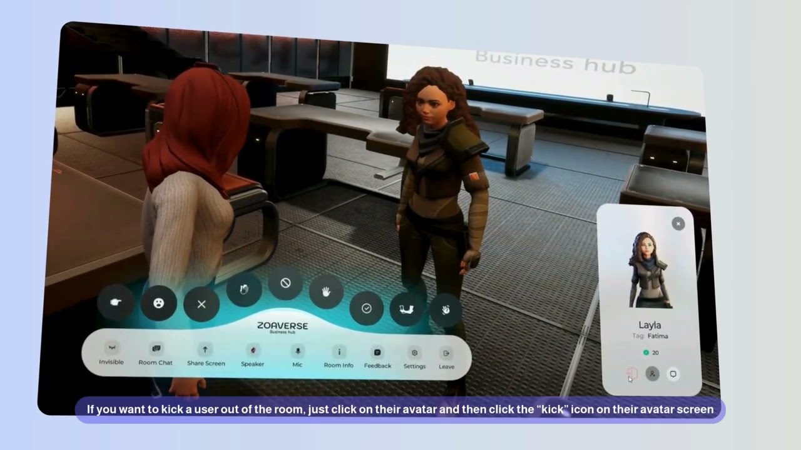
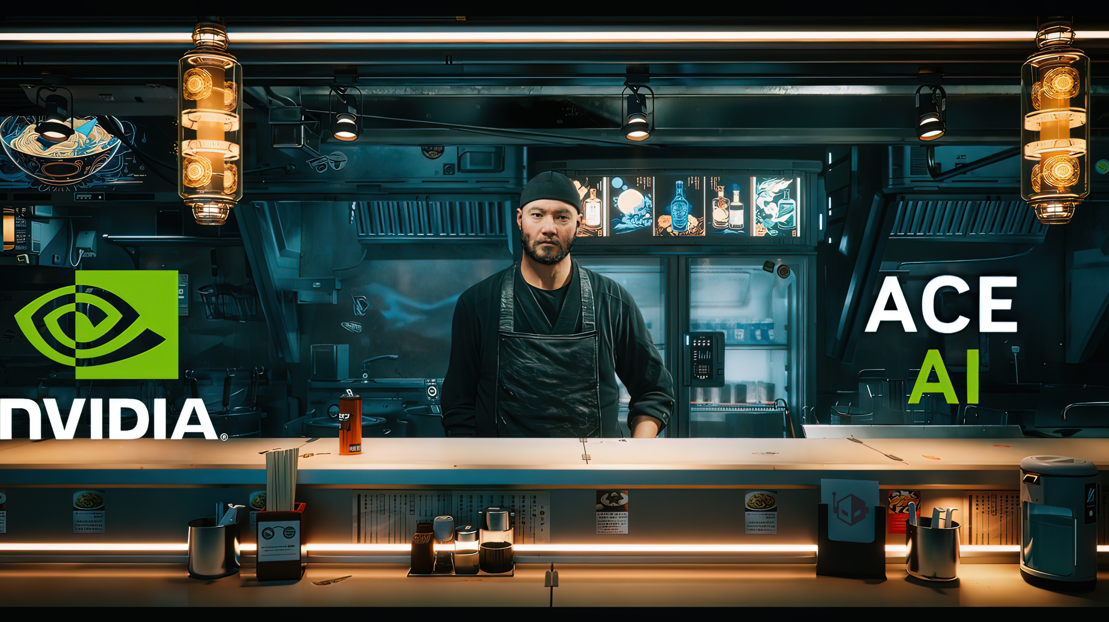
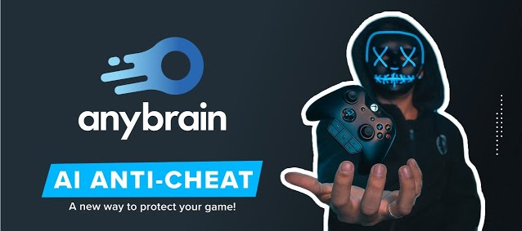
AI Innovation in Gaming
Enhanced player experience by adapting game to play style of player
The NPCs of the game are more realistic
Content is generated based on player actions in real time
Multiplayer is balanced by looking at how you play and others
Allow testing players to make better games

Slide 6
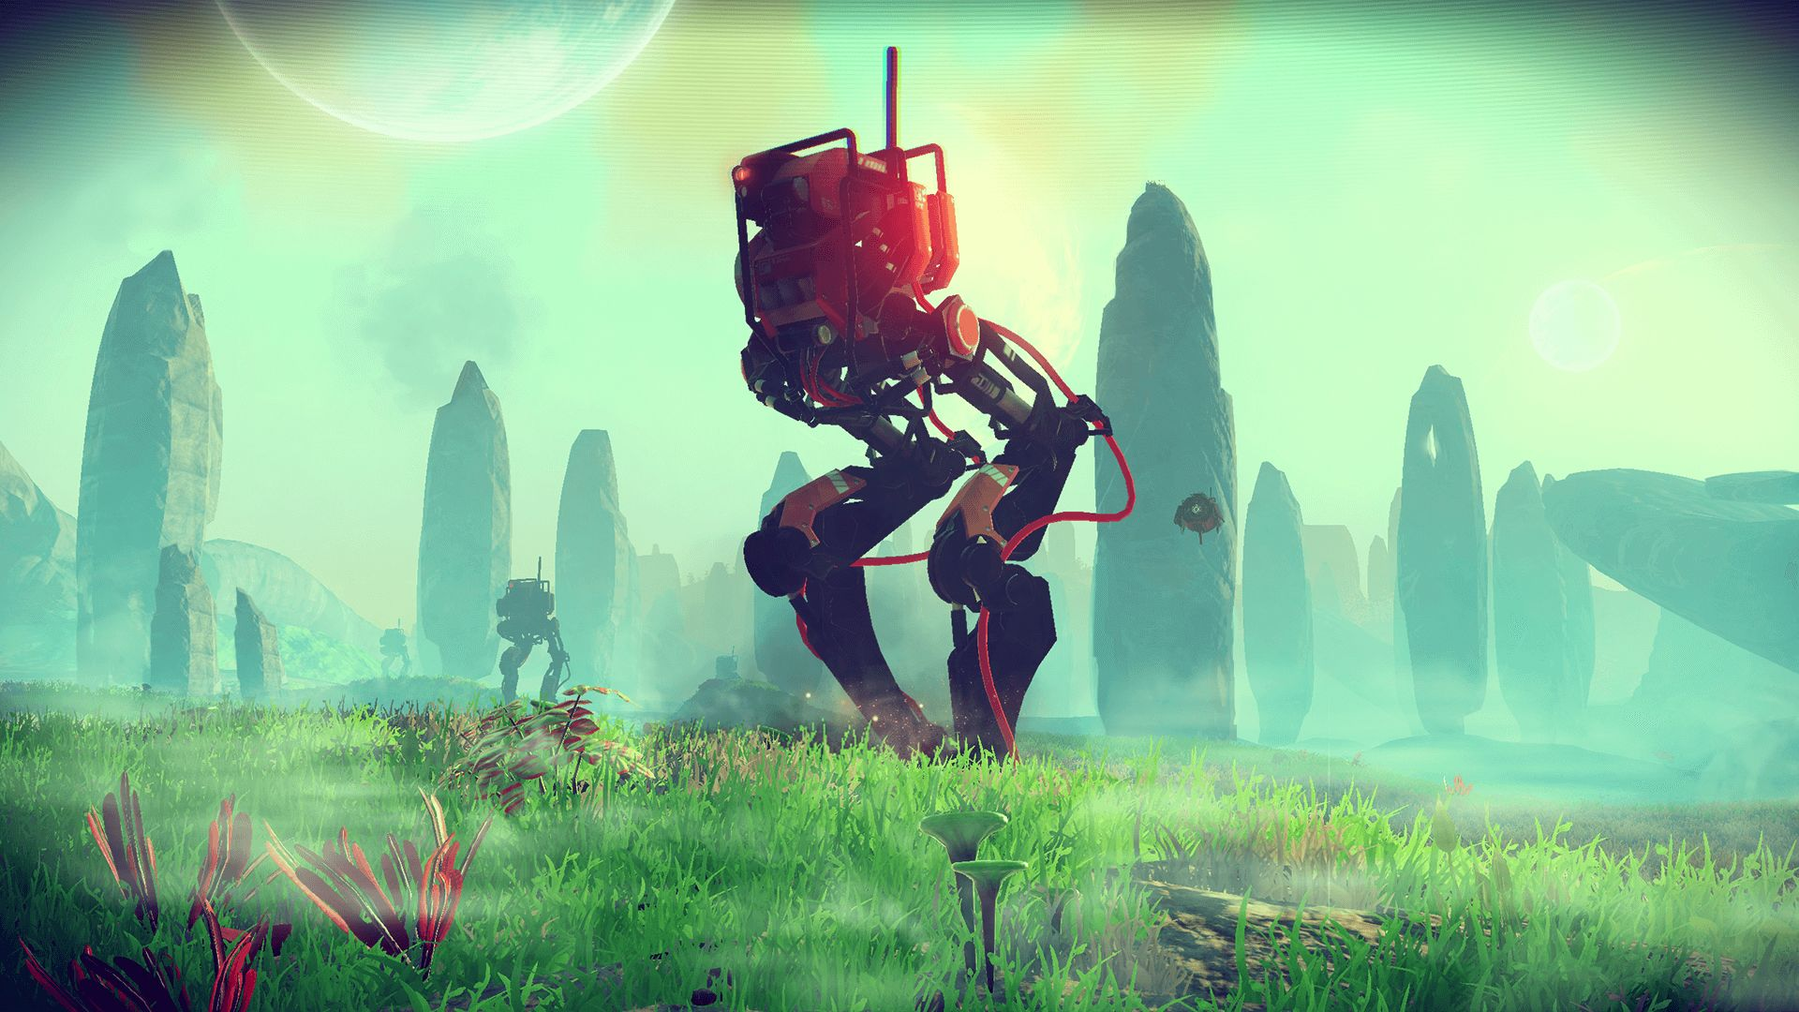
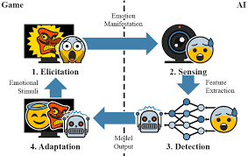
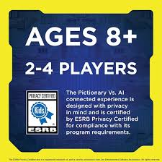
Swot Analysis of AI in Gaming
Strengths: Better user experience, player retention increased, content generation
Weaknesses: Privacy concerns, High Costs
Opportunities: Demand is growing, AI is advancing faster, many new metaverse and other projects opening
Threats: High competition, Ethical concerns on data handling / where it is stored / why, Addictive gameplay for children

Slide 7

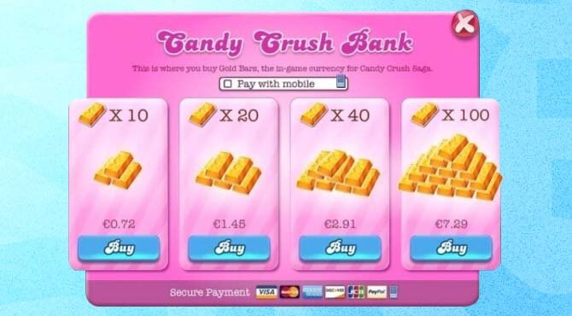

Monetization
AI has opened new revenue channels for companies
targeted ads to customers – if user loose level, he sees an advertisement
microtransactions in games – the new car can be unlocked by paying 5SAR.
Subscription model in games – Xbox game pass unlock all games for a month for 30SAR
It is also expanding to other sectors like virtual reality and augmented reality.

Slide 8

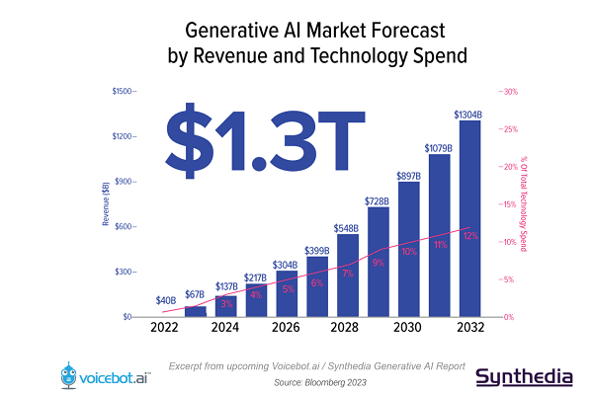

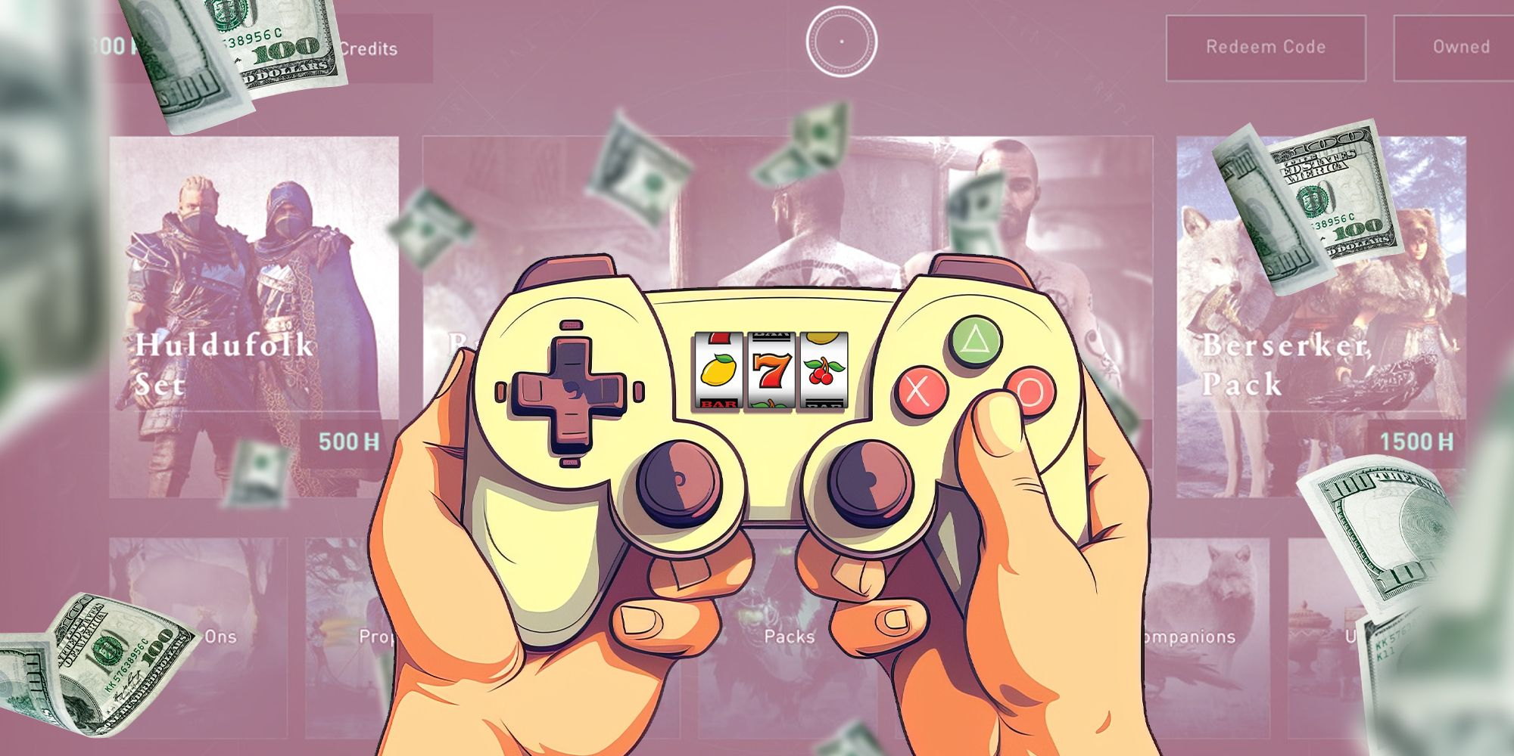
Conclusion
AI is a key driver for the future of gaming
KSA is becoming one of the main players of AI in gaming and new technologies like metaverse
Innovations will also lead to new revenue streams for companies like microtransactions in games.
Startups that are happening now days will redefine the future of gaming

Slide 9

References
All pictures are taken from google.
https://www.engati.com/blog/ai-for-gaming
https://astranova.world/about-us
https://www.zoaverse.com/
https://kafugames.com/blog/en/organize-esports-tournaments/
https://www.anodot.com/blog/gaming-monetization-using-ai-ml/
Notes:
14

